Slide 1
Data Visualization Lab
Terms, Concepts, and Definitions

Slide 2
Part B – Question 1
Correlation Coefficient

Slide 3
Correlation Coefficient
The correlation coefficient is a statistical measure that expresses the strength and direction of the relationship between two variables. It is a crucial concept in data analysis, helping to understand how one variable might predict or relate to another.

Slide 4
Types of Correlation
Positive Correlation: As one variable increases, the other variable also increases. For example, height and weight often have a positive correlation.
Negative Correlation: As one variable increases, the other decreases. For instance, the speed of a car and the time it takes to travel a fixed distance have a negative correlation.
No Correlation: There's no relationship between the two variables. An example would be the correlation between shoe size and intelligence.

Slide 5
Correlation Coefficient (r)
The Pearson correlation coefficient (denoted as r) is the most commonly used type. It can range between -1 and 1:
r = 1: Perfect positive correlation.
r = -1: Perfect negative correlation.
r = 0: No correlation.

Slide 6
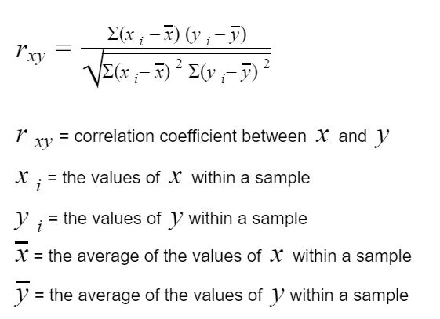
Formula for Pearson’s Correlation Coefficient

Slide 7
Correlation Coefficient
It is a numerical value that ranges from -1 to +1, where:
+1 indicates a perfect positive linear relationship: as one variable increases, the other increases as well.
0 indicates no linear relationship: changes in one variable do not predict changes in the other.
-1 indicates a perfect negative linear relationship: as one variable increases, the other decreases.

Slide 8
Values:
r = 1 : perfect positive linear relationship.
r = 0 : no linear relationship.
r = −1: perfect negative linear relationship.

Slide 9
Diagrammatic Representation
Positive Correlation: In a scatter plot, if the data points are closely aligned along an upward-sloping line, it indicates a positive correlation.
Negative Correlation: If the data points are closely aligned along a downward-sloping line, it indicates a negative correlation.
No Correlation: Data points scattered randomly, showing no discernible pattern, indicate no correlation.

Slide 10
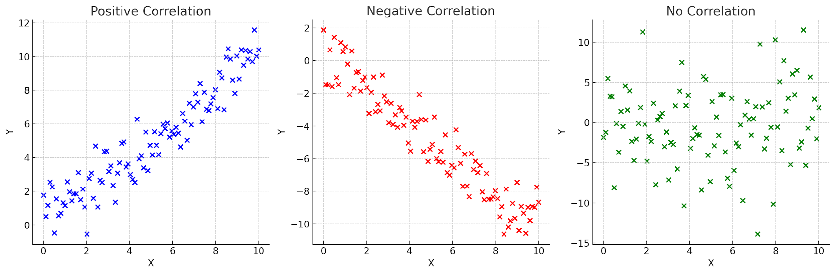

Slide 11
Visual illustrations of the different types of correlations:
Positive Correlation: The first plot shows how the points are scattered closely along an upward-sloping line, indicating a positive correlation.
Negative Correlation: The second plot illustrates a downward-sloping line where the points are aligned, representing a negative correlation.
No Correlation: The third plot shows points scattered randomly, indicating no clear relationship between the variables.

Slide 12
Part B : Q2
Linear Regression Model

Slide 13
Machine Learning

Slide 14
Definition
Machine learning uses algorithms to analyze data, identify patterns, and make decisions. The more data a machine learning system is exposed to, the better it performs.

Slide 15
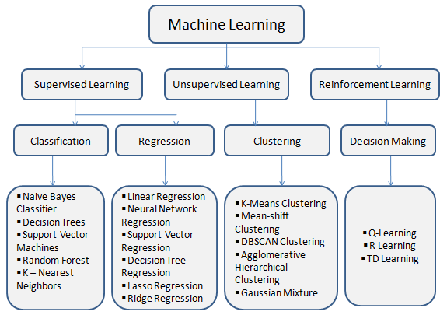
Categories

Slide 16
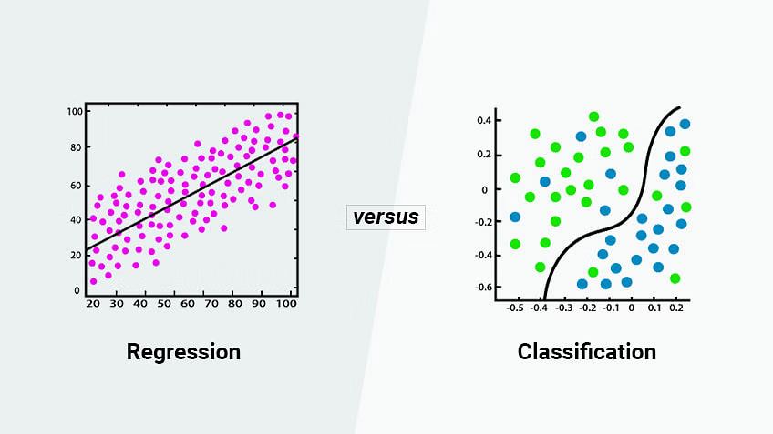
Difference between Classification and Regression

Slide 17
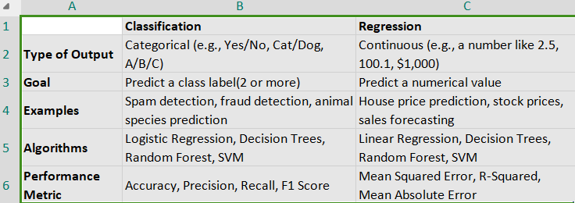

Slide 18
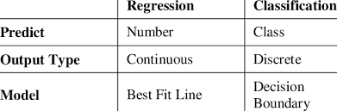

Slide 19
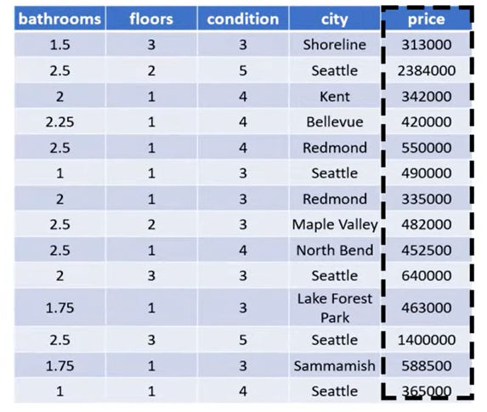
Prediction Data looks like this:

Slide 20
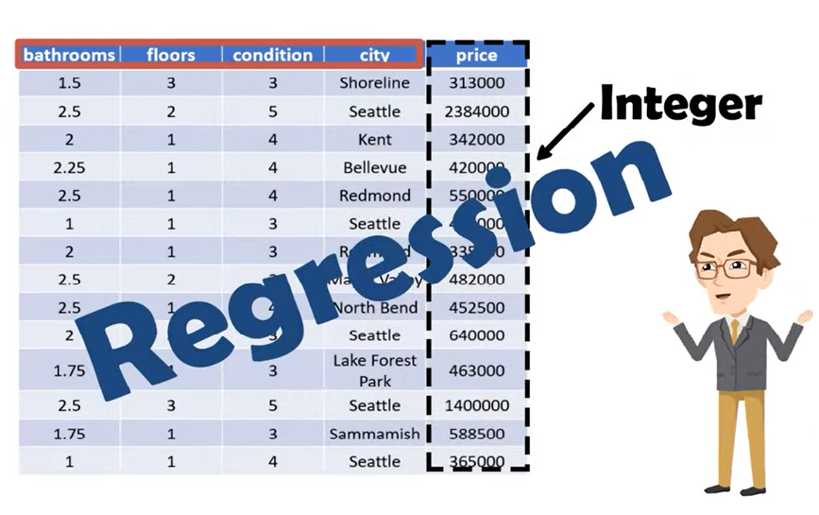

Slide 21
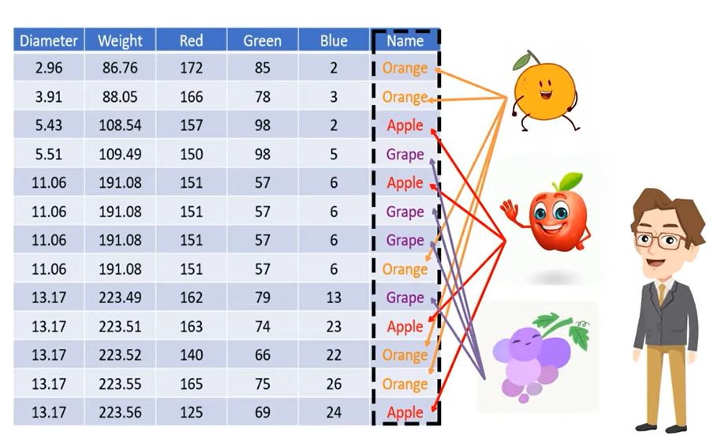
CLASSIFICATION

Slide 22
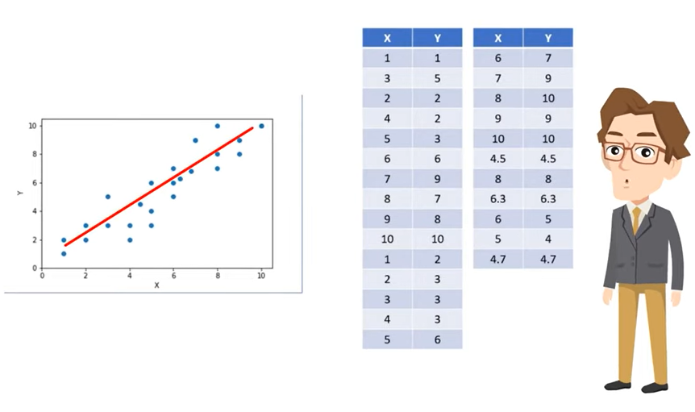

Slide 23
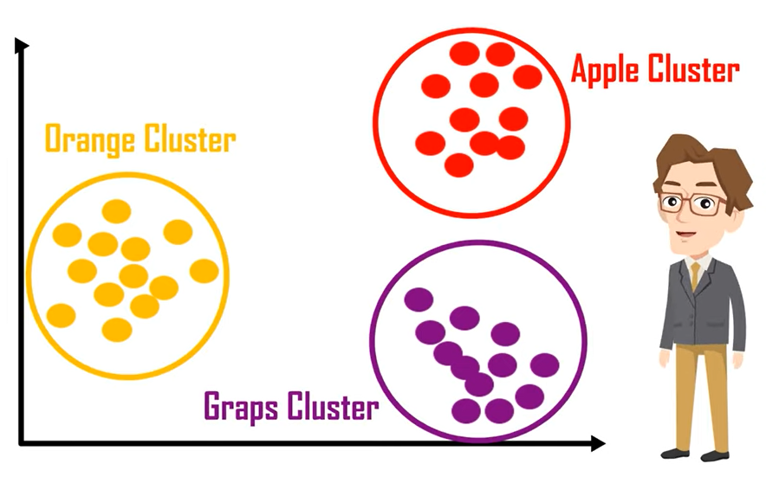

Slide 24
Linear Regression
What is Linear Regression?
A statistical method to model the relationship between a dependent variable and one or more independent variables.
Types:
Simple Linear Regression (one independent variable)
Multiple Linear Regression (multiple independent variables)
Applications:
Predictive modeling, trend analysis, finance, healthcare, etc.

Slide 25
Mathematical Background
Linear Equation: Y=mX+b
Y: Dependent variable
X: Independent variable(s)
m: Slope (coefficients in Python)
b: Intercept (constant in Python)
Goal: Minimize the sum of squared differences between actual and predicted values.

Slide 26
Data Requirements
Data Requirements:
Continuous dependent variable
Data without multicollinearity (for multiple regression)
Data with minimal outliers

Slide 27
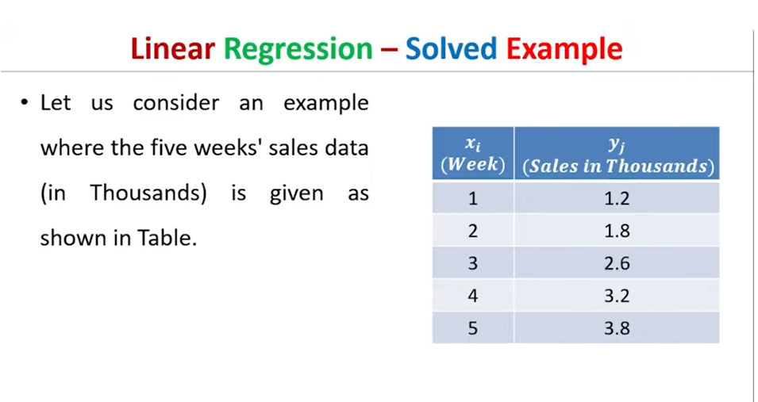
Linear Regression Example

Slide 28
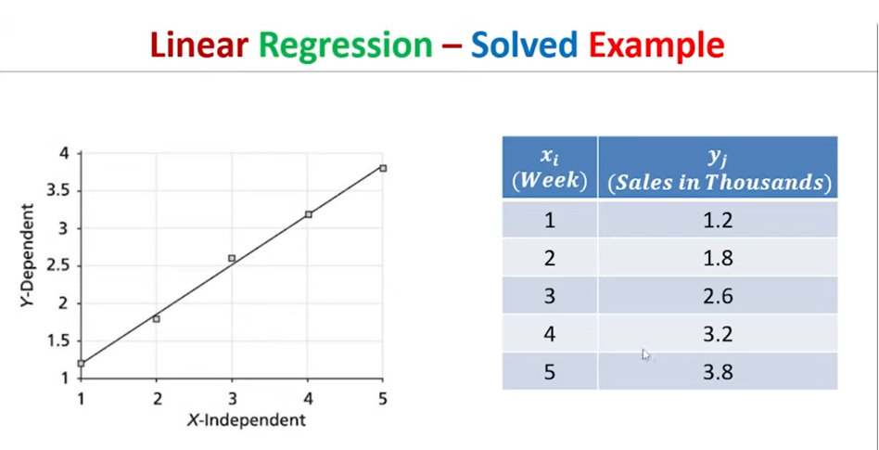

Slide 29
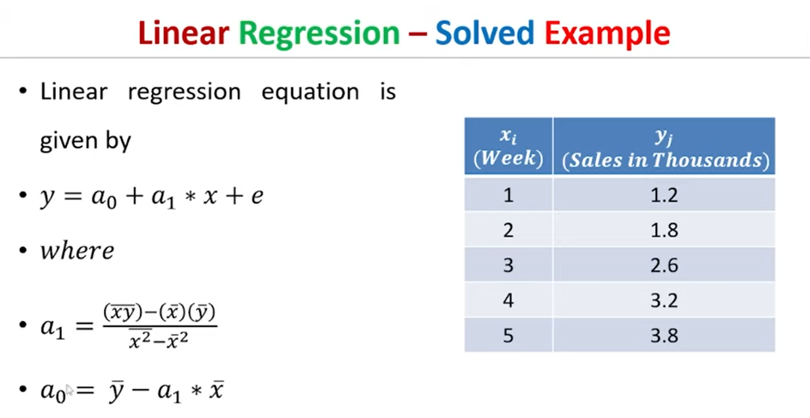

Slide 30
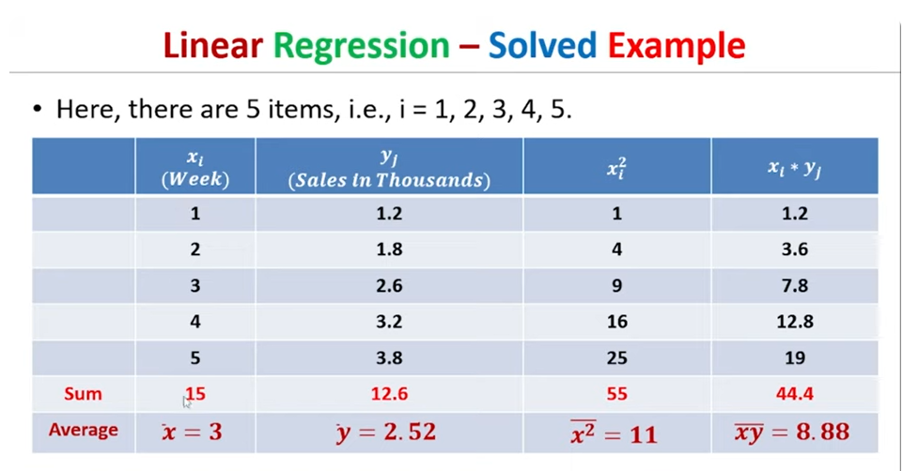

Slide 31
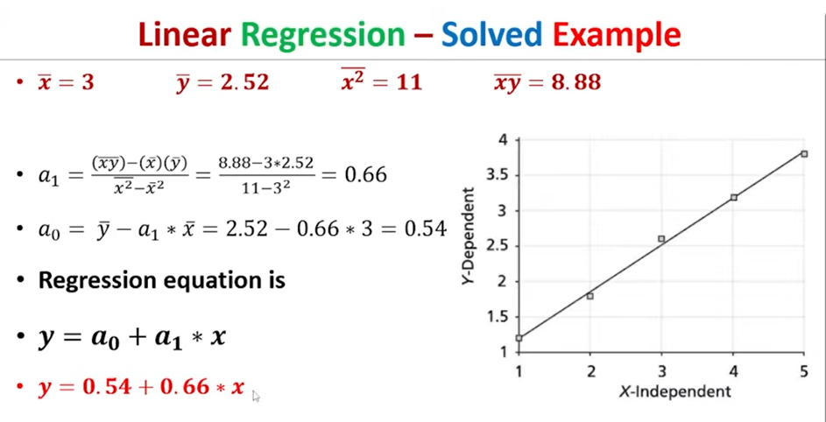

Slide 32
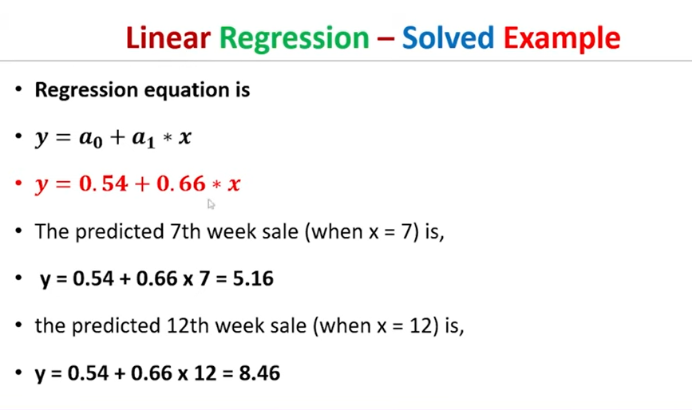

Slide 33
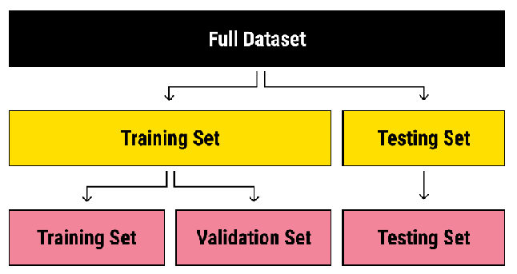
Machine learning Split : Train and Test data

Slide 34
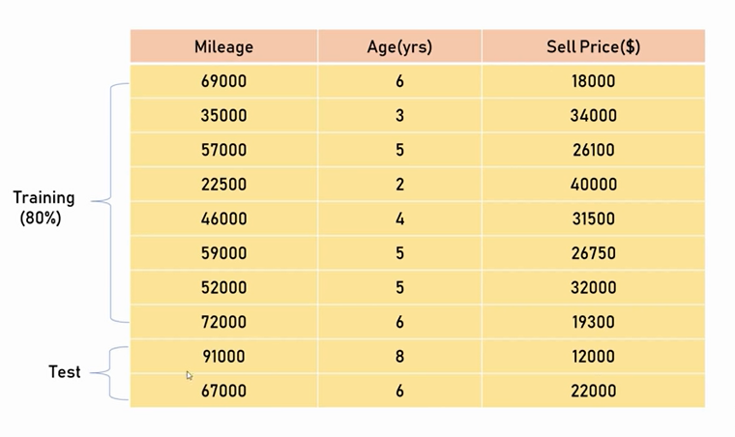

Slide 35
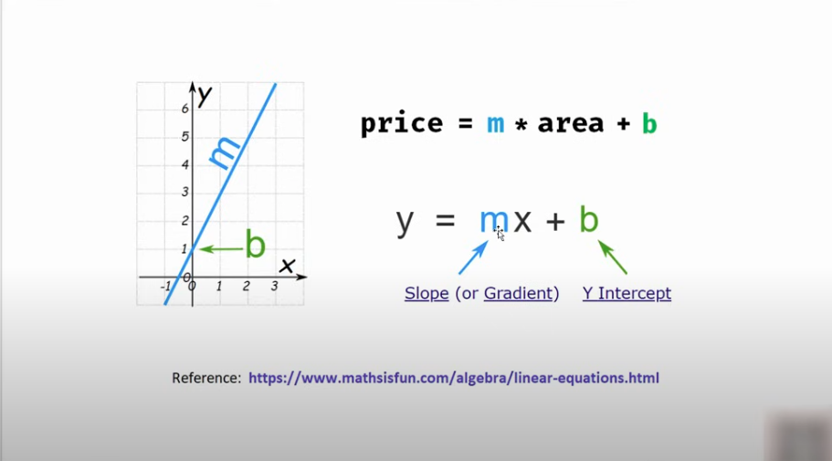

Slide 36
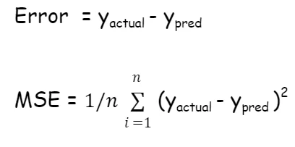
The error is the difference between the predicted output and the actual output.

Slide 37
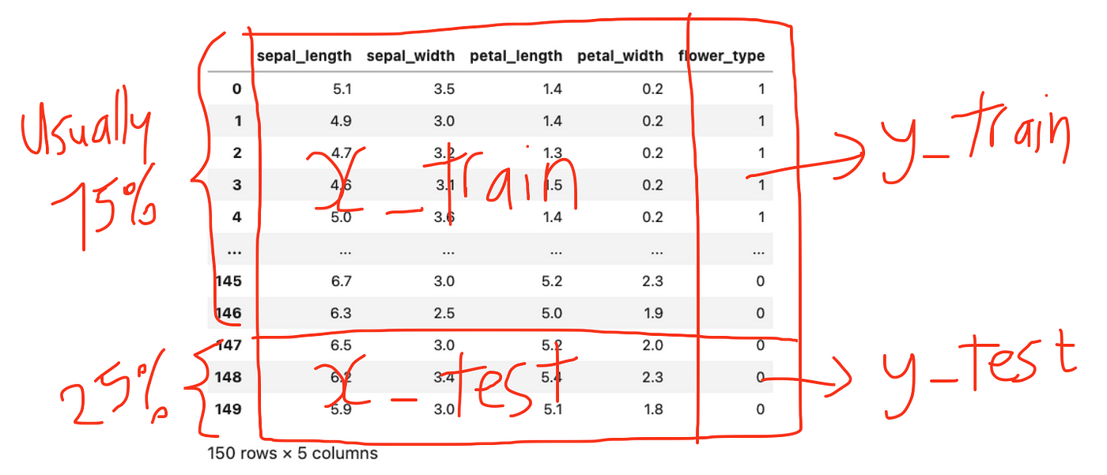

Slide 38
F-Test for Overall Model Significance
What is the F-Test?
The F-test is used to determine whether your regression model provides a better fit to the data Essentially, it tests if your independent variable (temperature) significantly improves the prediction of the dependent variable (efficiency).
The F-test confirms that including temperature in the model is much better than using no predictors at all.

